Slide 1



Sustainable Supply Chain Performance Dashboard
- By Mohammad Sameer

Slide 2

Learning Objectives
Analyze product performance in skincare, haircare, and cosmetics using Power BI, focusing on revenue and supply chain efficiency. Master inventory and supplier performance metrics like stock levels, lead times, and defect rates to optimize operations. Evaluate transportation and logistics performance, including costs and delivery efficiency. .Develop interactive dashboards to track customer demographics and purchasing patterns for demand alignment. Build Power BI visualizations to integrate sustainable supply chain management, driving data-driven decisions from manufacturing to quality control.
GOAL
Source :
www.freepik.com/

Slide 3
Tools and Technology used
Power BI:
Power BI is a business analytics tool developed by Microsoft that allows users to visualize and analyze data in an interactive way.
It connects to a wide range of data sources, including databases, spreadsheets, and cloud services, to gather and consolidate information.
Users can create reports and dashboards to display key metrics and insights, making data accessible and understandable.
Power BI supports real-time data updates and allows for easy sharing of reports with team members and stakeholders.
With its powerful features, Power BI helps businesses make informed decisions by turning raw data into actionable insights.

Slide 4
Methodology
We have used different types of graphs and charts for creating complete dashboard. They are :
1.Stacked Column Chart:
This chart displays data in vertical bars, where each bar is divided into segments representing different categories or subcategories. It's useful for comparing parts to the whole across different categories.
2.Clustered Bar Chart:
This chart displays bars for different categories side by side, making it easy to compare multiple data series within the same category. Each category has separate bars for each series, allowing for clear comparison across groups.
3.Pie Chart:
This chart displays data as slices of a circular chart, with each slice representing a proportion of the total. it’s most effective with a limited number of categories for clarity.
4.Slicer:
It’s a visual filter that allows users to select specific values or ranges of data, dynamically updating the visuals on the report. Slicers can be applied to various visuals on the same report to synchronize filtering.

Slide 5
Problem Statement:
1.Understanding the sum and average of products sold by each route in different locations?
2.Understanding the stock levels for each product in different locations ?
3.Knowing stock levels hold by each supplier ?
4.Finding sum of order quantities of each product ?
5.Understanding products sold by each supplier in different locations ?
6.Calculating revenue generated by each product ?
7.Comparing the shipping cost and shipping times for different transportation modes ?
8.Finding the defect rates in each product ?
9. Calculating average of shipping costs and shipping times for each product type ?
10.Counting which customer demographic are using each product ?

Slide 6
Solution:
1A) By using Stacked column chart, we can understand products sold by each route. We take routes on
X-axis, sum and avg no of products sold on Y-axis.
2A)By using Stacked column chart, we can understand stock levels by each product. We take product type
on X-axis, sum of stock levels on Y-axis .
3A)We can know stock levels hold by each supplier using pie chart, by taking supplier name as legend
and sum of stock levels as values.
4A)By using stacked bar chart, we can find order quantities by each product type. We take product type
on Y-axis and sum order quantities on X-axis.
5A)By using pie chart, we can understand products sold by each supplier. We take supplier name as
legend and sum of products sold on Values field.
6A)By using pie chart, we can calculate revenue generated by each product . We take product type as
legend and avg of revenue generated on Values field.
7A)By using clustered bar chart, we can shipping cost and shipping times for different transportation
modes. We take transportation modes on X-axis and shipping cost, times on Y-axis.
8A)By using pie chart, we can find defect rates in different products. We take product type on legend field
and sum of defect rates on values field.
9A)By using clustered column chart, we can calculate avg of shipping costs & times for each product.
10A) By using clustered column chart, we can count which customer is using which product .

Slide 7
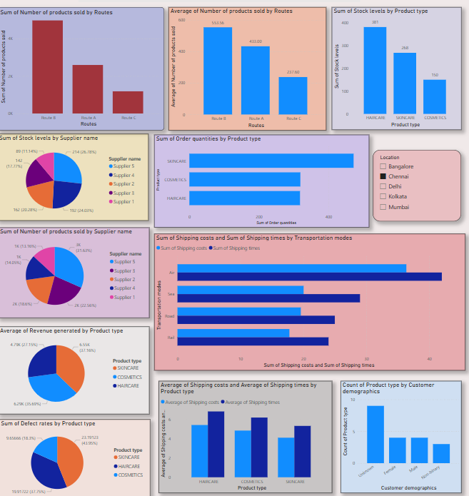
Screenshot of Output:

Slide 8
Conclusion:
By Using Power BI to analyze key metrics across sales, inventory, supplier performance, logistics, and customer demographics empowers businesses to make data-driven decisions. The mix of visualizations ensures a well-rounded view of operations, while interactive dashboards enable continuous monitoring and optimization. By applying this comprehensive approach, businesses in sectors like skincare, haircare, and cosmetics can boost their operational efficiency, align demand with customer needs, improve product quality, and optimize supply chain management for both profitability and sustainability.

